Slide 1

DevOps
Presented By:-
Sanmati Patil

Slide 2
Introduction
DevOps Architecture Features
Architecture
Components
Tools
Principles
Advantages
Disadvantages

Slide 3

Introduction
The DevOps is the combination of two words, one is Development and other is Operations. It is a culture to promote the development and operation process collectively.

Slide 4
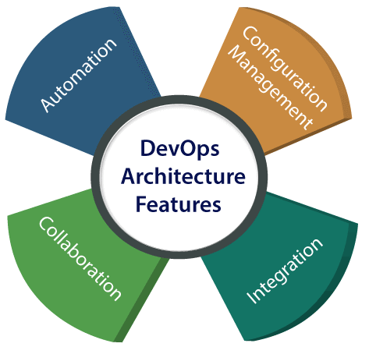
DevOps Architecture Features
1)Automation can reduce time consumption, especially during the testing and deployment phase.
2) Collaboration
The Development and Operations team collaborates as a DevOps team, which improves the cultural model as the teams become more productive with their productivity, which strengthens accountability and ownership
3) Integration
Applications need to be integrated with other components in the environment. The integration phase is where the existing code is combined with new functionality and then tested.
4) Configuration management
It ensures the application to interact with only those resources that are concerned with the environment in which it runs.

Slide 5
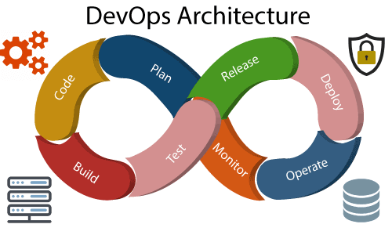

Slide 6
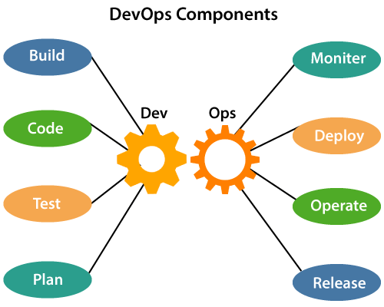

Slide 7
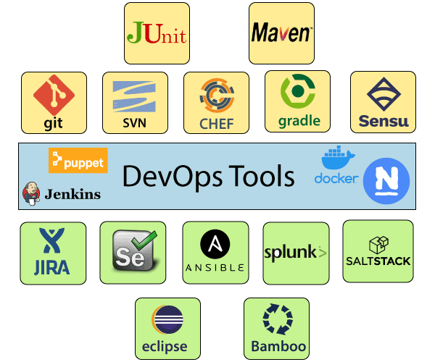
DevOps Tools

Slide 8
DevOps Principles
Continuous Improvement: DevOps culture focuses on continuous improvement to minimize waste. It continuously speeds up the growth of products or services offered.
Automate Everything: Automation is an essential principle of the DevOps process. This is for software development and also for the entire infrastructure landscape.
Custom Centric Action: DevOps team must take customer-centric for that they should continuously invest in products and services.
End to End Responsibility: DevOps team need to provide performance support until they become the end of life. It enhances the responsibility and the quality of the products engineered.
Monitor and test everything: The DevOps team needs to have robust monitoring and testing procedures.
Work as one team: In the DevOps culture role of the designers, developers, and testers are already defined. All they needed to do is work as one team with complete collaboration.

Slide 9
DevOps Advantages and Disadvantages
Advantages
DevOps is an excellent approach for quick development and deployment of applications.
It responds faster to the market changes to improve business growth.
DevOps escalate business profit by decreasing software delivery time and transportation costs.
DevOps clears the descriptive process, which gives clarity on product development and delivery.
It improves customer experience and satisfaction.
DevOps simplifies collaboration and places all tools in the cloud for customers to access.
DevOps means collective responsibility, which leads to better team engagement and productivity.

Slide 10
Disadvantages
DevOps professional or expert's developers are less available.
Developing with DevOps is so expensive.
Adopting new DevOps technology into the industries is hard to manage in short time.
Lack of DevOps knowledge can be a problem in the continuous integration of automation projects

Slide 11
THANK YOU

